Slide 2

Automating Azure SQL Data Warehouse
THR2192
Greg Galloway, Artis Consulting
September 26, 2018

Slide 3

Agenda
TASKS TO AUTOMATE
Backup DW
Resume DW
Pause DW
Key rotation
TOOLS
Azure Data Factory v2
Azure Automation
Command line
Code Samples and Resources
https://github.com/furmangg/automating-azure-sql-dw

Slide 4

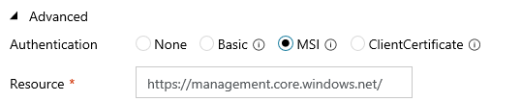
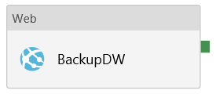
Backup DW from Azure Data Factory v2
BackupAzureSQLDW
code sample
Uses ADFv2 built-in Web activity
Uses ADF Managed Service Identity (MSI)
Ensures a user-defined restore point is created at the beginning or end of your load

Slide 5
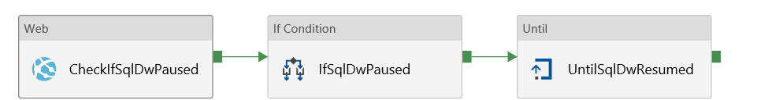
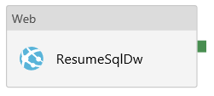
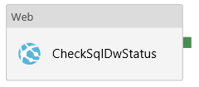
Resume DW from Azure Data Factory v2
ResumeAzureSQLDW
code sample
Uses ADFv2 built-in activities
Uses ADF Managed Service Identity (MSI)
True Activities

Slide 6
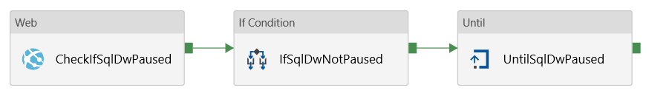
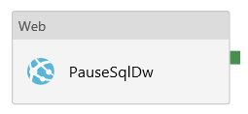
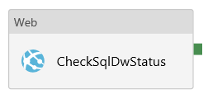
Pause DW from Azure Data Factory v2
PauseAzureSQLDW
code sample
Uses ADFv2 built-in activities
Uses ADF Managed Service Identity (MSI)
True Activities

Slide 7
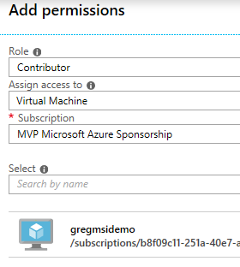
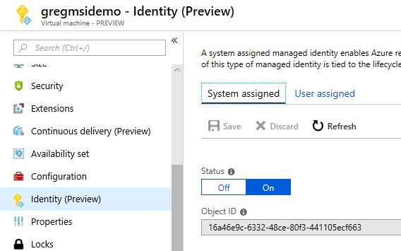
Resume DW from CLI
resumeDW.bat
code sample
If running in Azure VM, enable Managed Service Identity (MSI)
Grant Contributor permissions to Azure SQL Server to MSI
Azure CLI can auth with no password
call az login --identity
call az account set -s <subscription_id>
call az sql dw resume
--resource-group <resource_group>
--server <server>
--name <database>
TIP: Without “call” the Windows .bat will stop after line 1

Slide 8







Rotate Keys with Azure Automation
RotateKeys.ps1
code sample
Changes SQL passwords and storage keys; updates Azure Key Vault, Azure Analysis Services, and Polybase database scoped credential
Azure
Automation
admin
Azure Blob
Storage
Polybase
credential
Azure SQL Data Warehouse
CubeReadOnly
Azure Analysis
Services
key
AdfLoader
SSAS data source credentials
Azure Key
Vault
Azure Data
Factory
dw-admin-password
dw-CubeReadOnly-password
dw-AdfLoader-connectionstring
THE END
storage-connection-string

Slide 9
Please evaluate this session Your feedback is important to us!
From your PC or Tablet visit MyIgnite at http://myignite.microsoft.com
From your phone download and use the Ignite Mobile App by scanning the QR code above or visiting https://aka.ms/ignite.mobileapp

